Slide 1
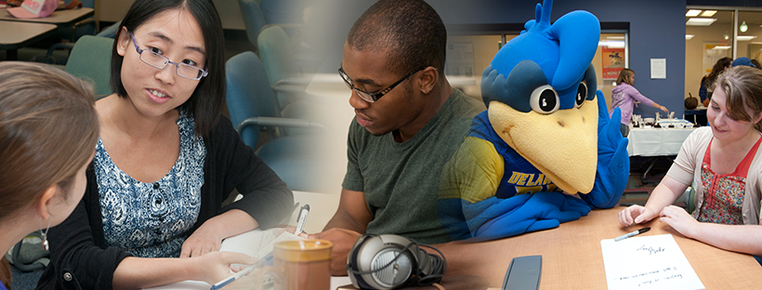
&
One university, many voices

Slide 2
What is a writing center?
Why does UD have one?
The University Writing Center is a place for the UD community—undergraduates, graduate students, faculty, and staff—to talk and learn about written and spoken communication.
The University of Delaware recognizes the importance of writing and speaking as ways college students create and share knowledge. So, we provide support through the Writing Center and Oral Communication Studio.
"By words we learn thoughts, and by thoughts we learn life." —Jean Baptiste Girard
“Words matter.”
–Michelle Obama

Slide 3
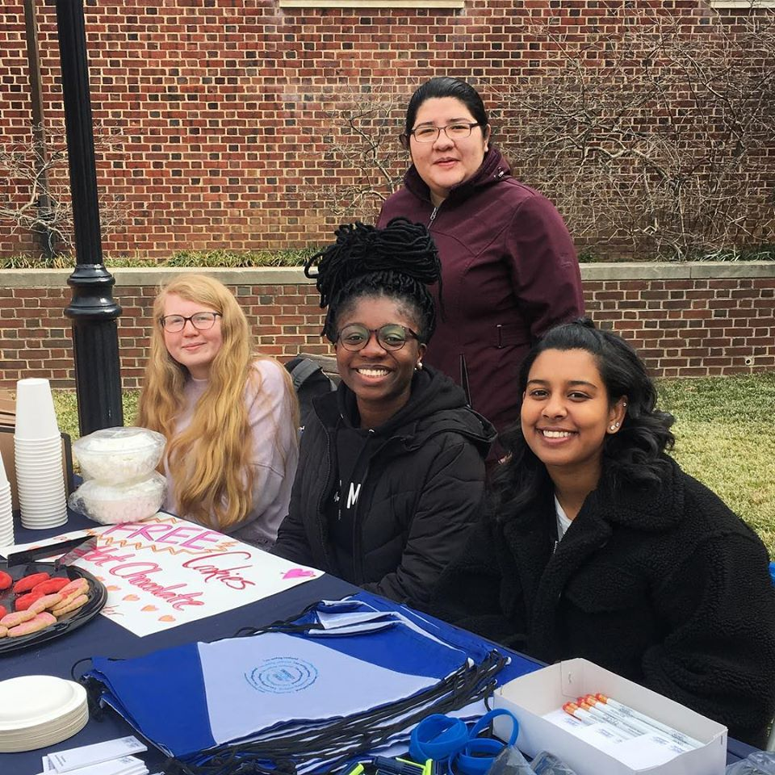
What does the writing center do?
Writing Center folks giving hot chocolate and cookies to hard working student writers!
Workshops
Guest speakers
Special events
Writing groups for graduate students
In-class support
Individual consultations with peer writing tutors and oral communication consultants:
Focused on your actual writing or communication
At any stage in the writing process
On any writing or speaking project

Slide 4
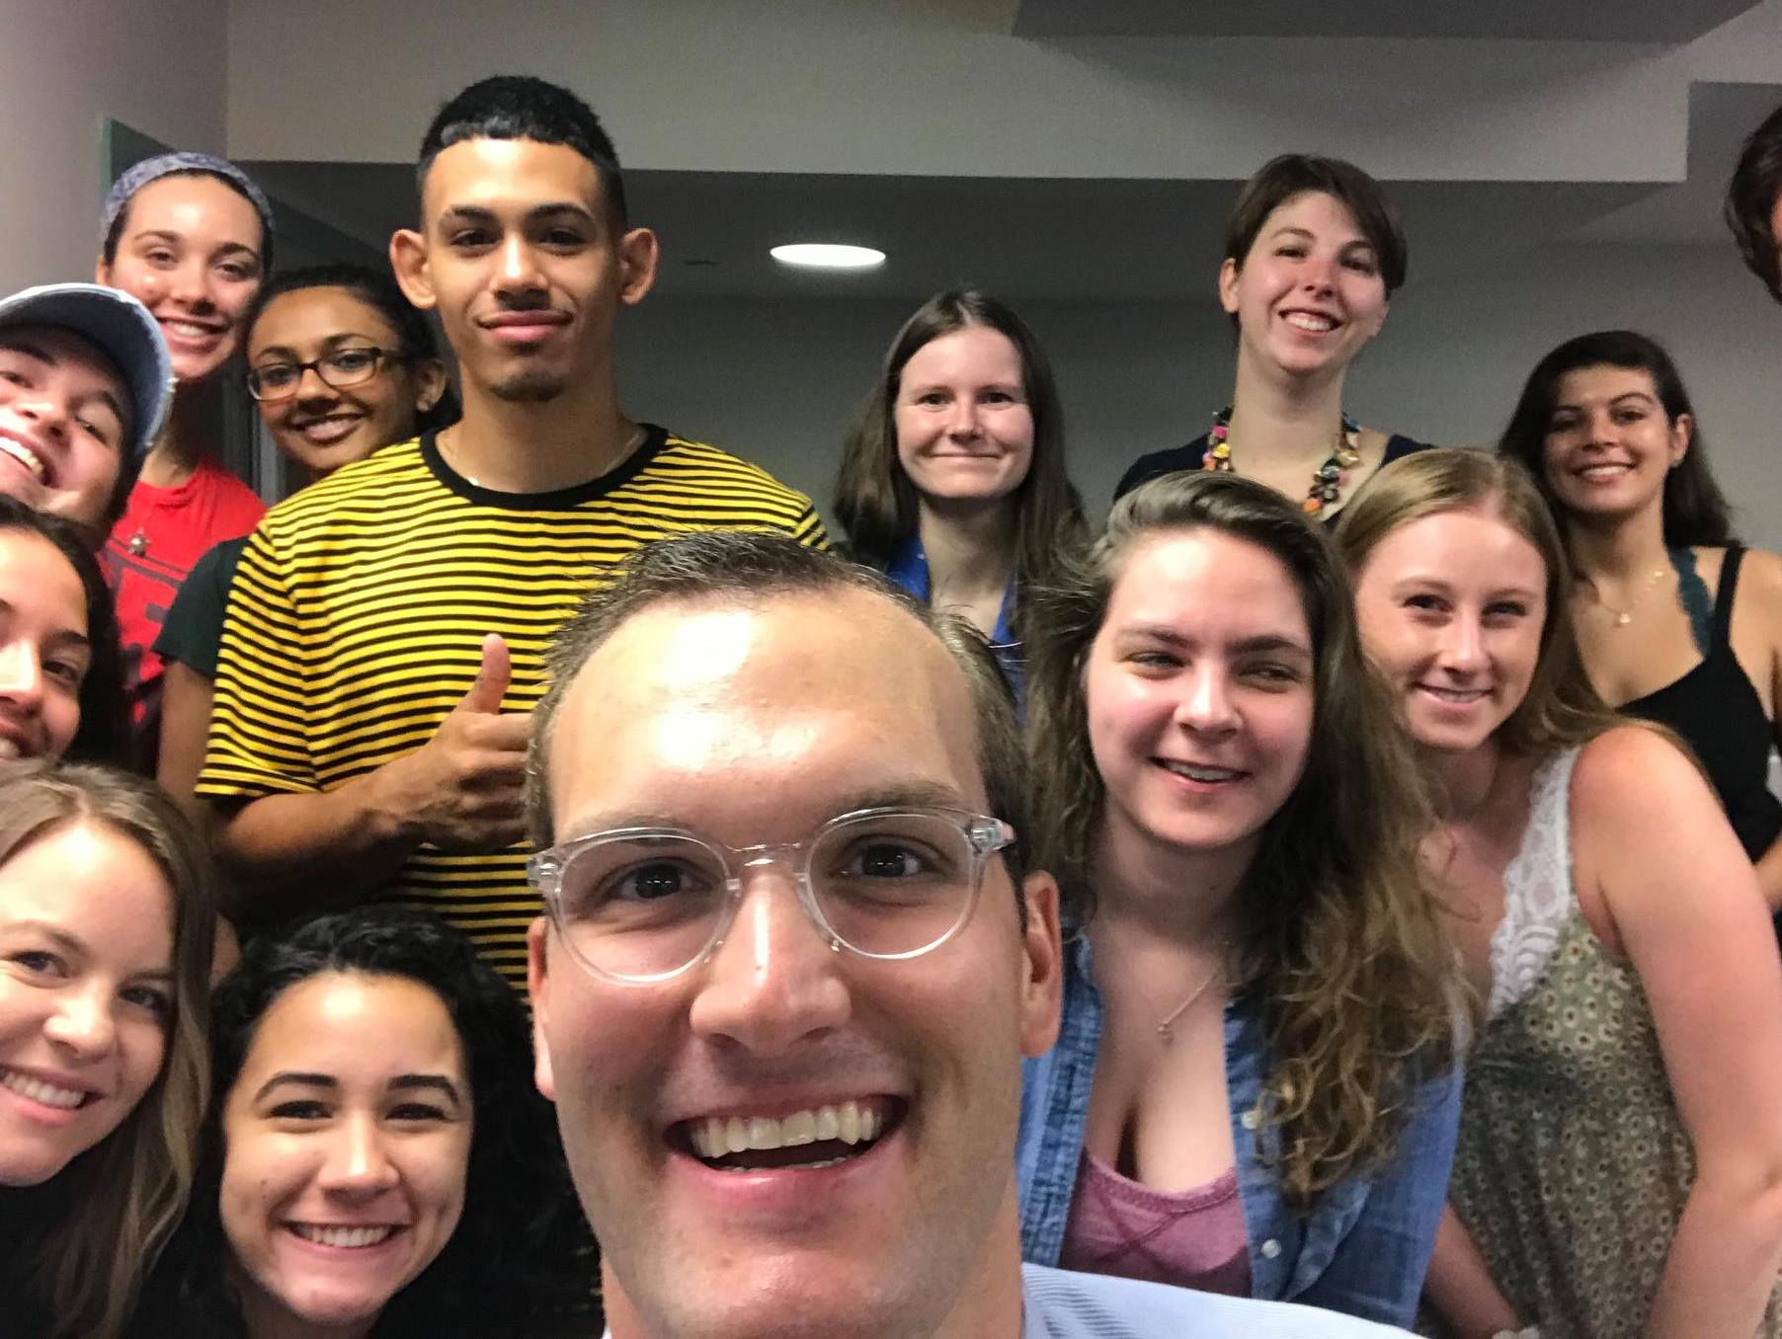
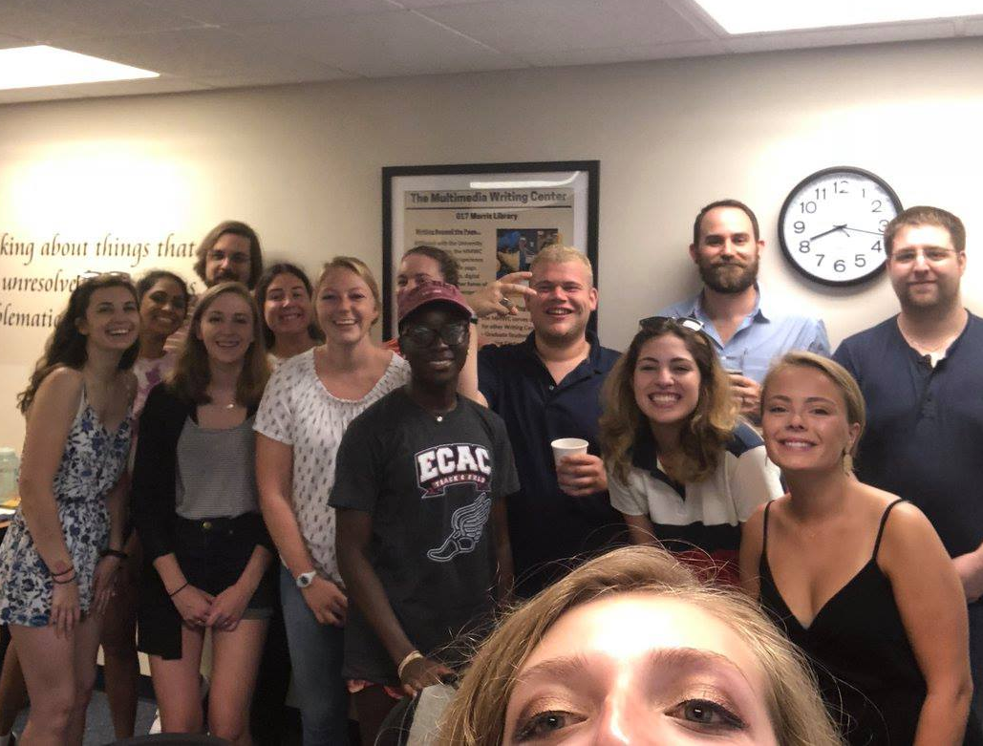
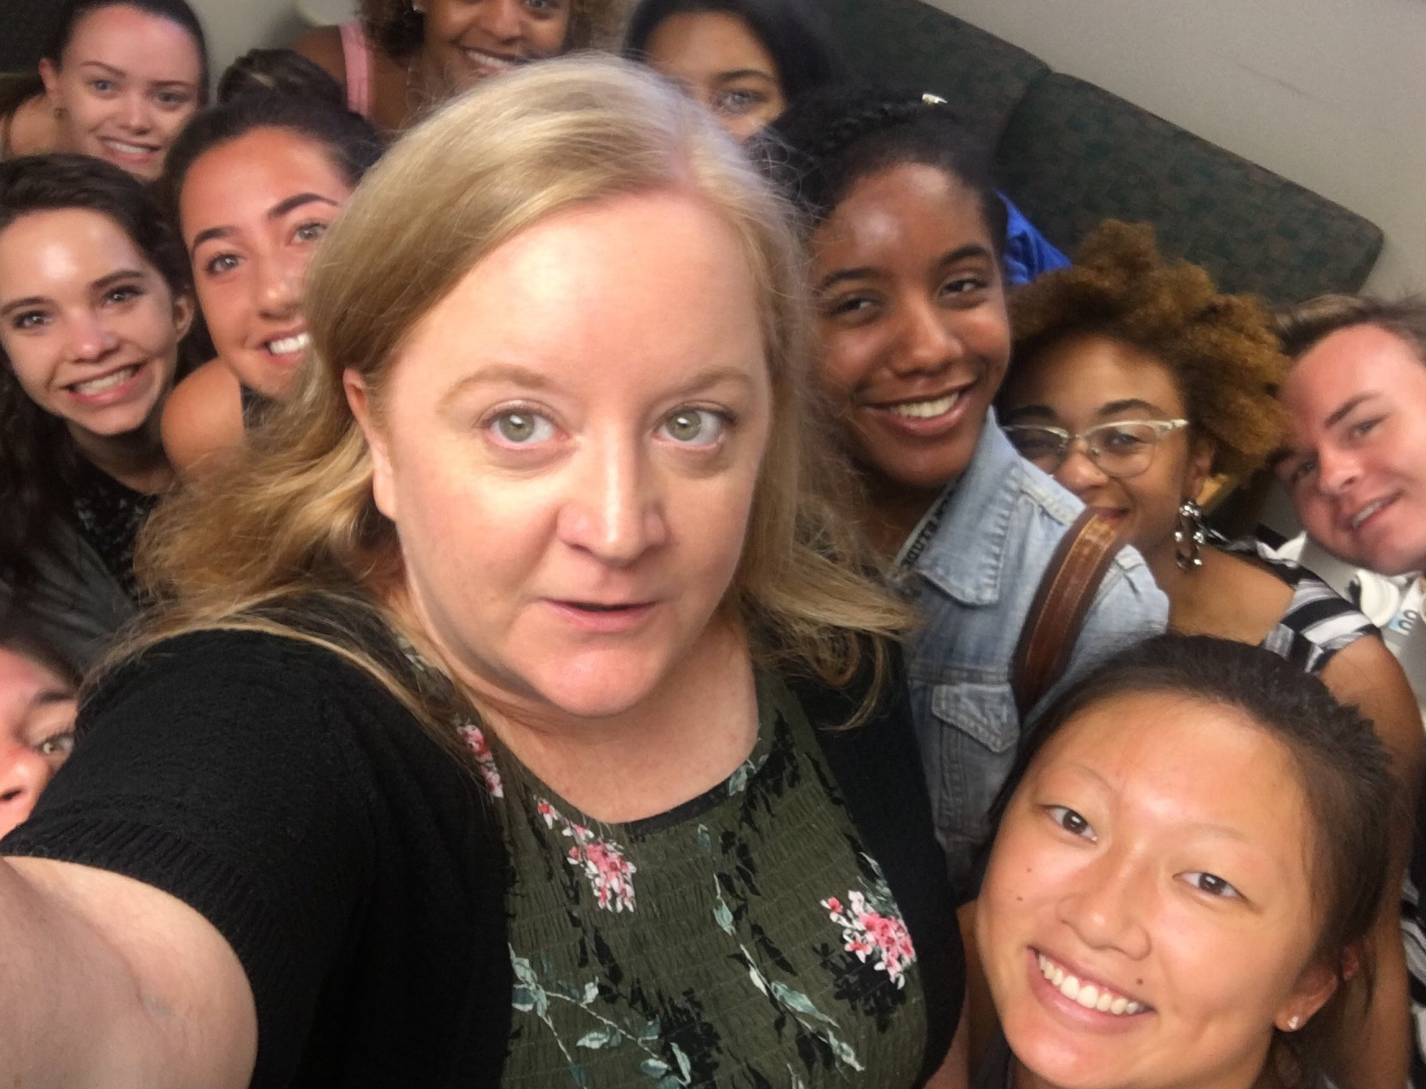
Who works in the Writing Center?
Undergraduates:
Peer Writing Tutors
Oral Communication consultants
Take a 3-credit class to prepare
Represent many majors
Graduate Writing Tutors:
PhD students in English
Tutors, Oral Comm Consultants, and WC Administrators in our obligatory first staff meeting of the year selfies

Slide 5
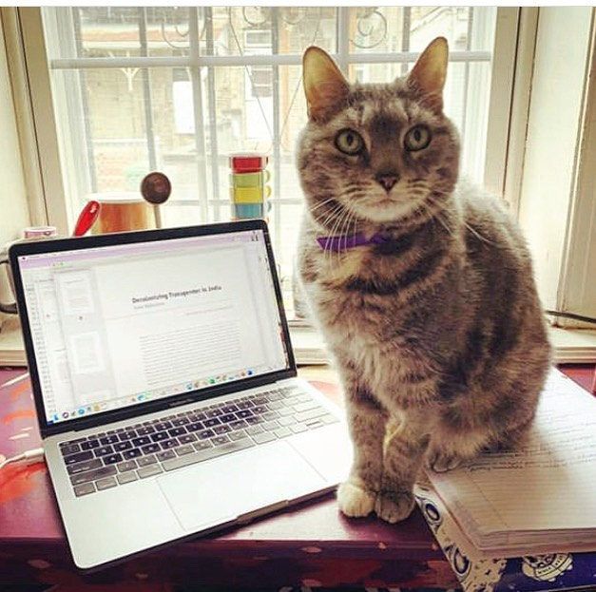
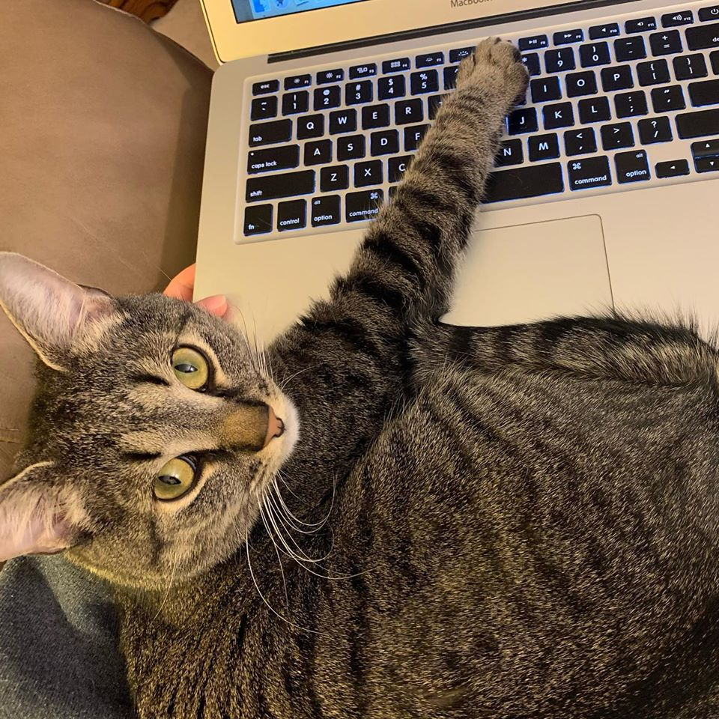
How does an appointment with a tutor work?
Online real-time tutoring:
Oral Communication consultant or peer writing tutor
Meet in real-time with a peer tutor through Wconline (video, audio, and a white board)
45-50 minutes to discuss what you’re working and offer feedback
You will be actively involved!
Disclaimer: most of our tutors are not cats.
Etutoring:
Peer writing tutors only
Make an appointment & upload your draft and an assignment sheet (if you have one)
Receive an email with written feedback

Slide 6
How to Make an Appointment
You may have as many as one appointment per day—five per week!
Step 1: Visit https://udel.mywconline.net/
(you can also get there by visiting our website, www.writingcenter.udel.edu, and choosing “make an appointment”)
Step 2: Register for access to wconline with your UD email address
Step 3: Select a schedule—writing tutors or oral communication consultants

Slide 7
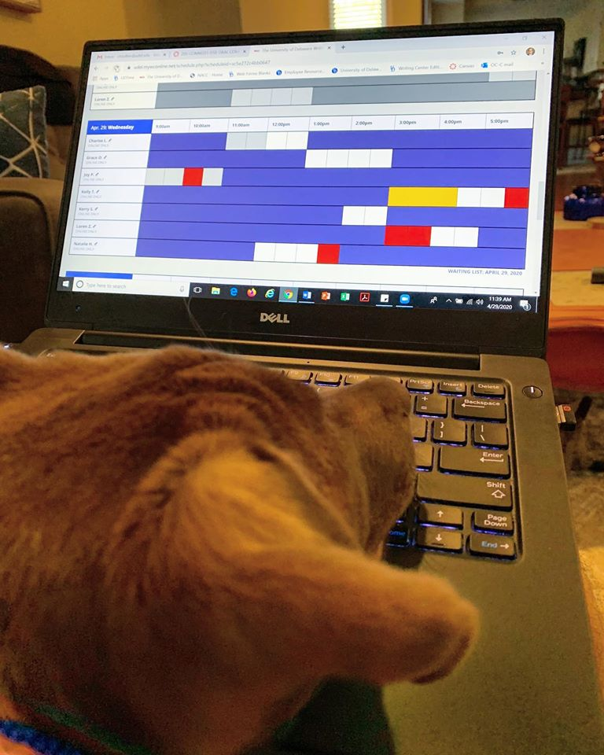
Choose your appointment
White boxes indicate open appointments. Click the box and complete the information it asks for.
If you choose etutoring, you may upload your draft and assignment sheet when you make the appointment or add it later—just be sure to do it before the start time of your appointment.
For real-time online appointments, sign back in to wconline and click your appointment. Your tutor will meet you there.
So many options! It’s hard for a pupper to choose.

Slide 8
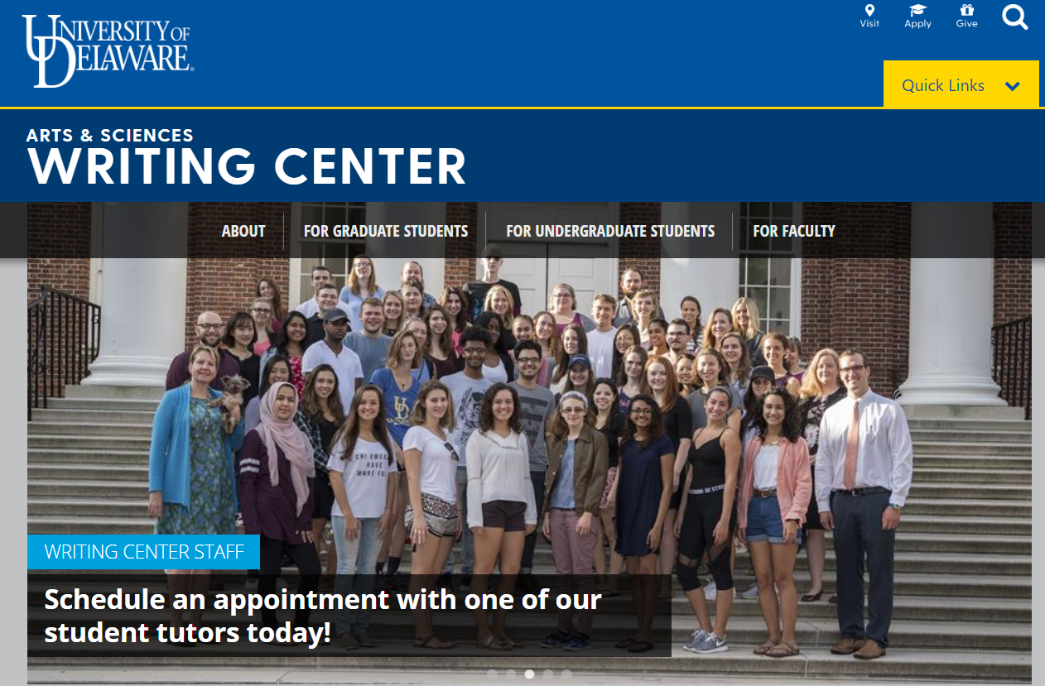
Where do I learn more?
UDWC website:
www.writingcenter.udel.edu
Detailed instructions for making appointments
Information about workshops and other services
Other resources for writers
Follow us on Instagram, Twitter, and Facebook:
@UDWritingCenter

